Slide 1

Bystander Intervention Training
Young Adult Gathering
Quaker Intentional Community--Canaan
Notes:
-Don introduces us
-Shirley welcomes everyone and says a little bit about her work in cultural competencies and why she’s interested in spreading skills in bystander intervention.
-Spee explains why she’s interested in spreading skills in bystander intervention and where this curriculum comes from.

Slide 2

Ending Descrimination/Peacebuilding
Notes:
-Spee… where this curriculum comes from (3 slides total)

Slide 3

LONG TERM GOAL:
Reduce profiling and surveillance of Muslim Community in Chicago, Boston, Indianapolis, & Greensboro
Notes:
-Spee… where this curriculum comes from

Slide 4
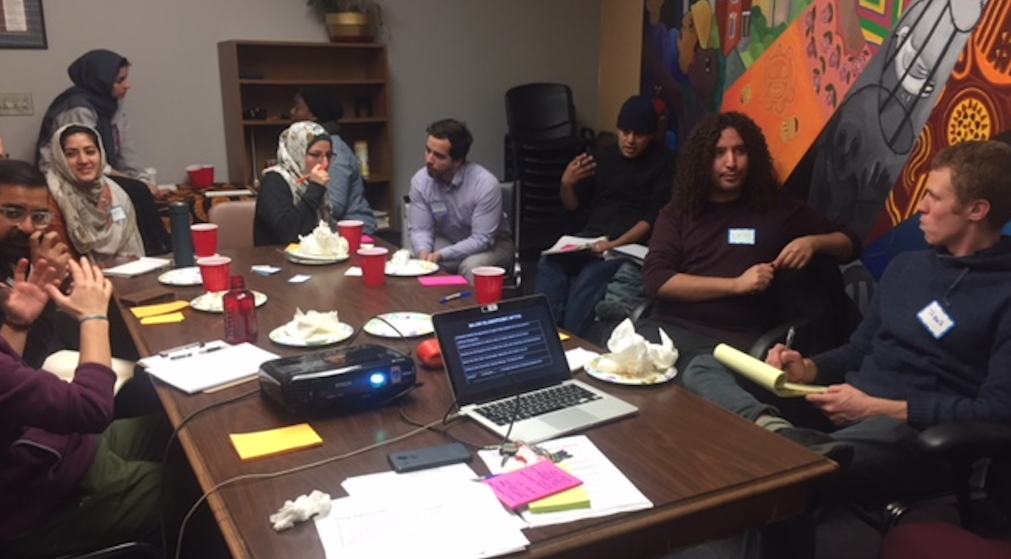
OUR STRATEGIES:
Training allies and Muslims to develop an educated base to support Muslim led organizing and intervene in anti-Muslim harm at the individual and state level.
Notes:
-Spee… where this curriculum comes from

Slide 5
What this is for:
Building confidence for situations as a 3rd Party or Stranger
Sharing tips and using collective knowledge in the room to gain ideas and confidence
To get used to MESSINESS when trying to respond (because harassment and interpersonal violence are messy)
Notes:
-Shirley to explain – maybe suggest people find a buddy for the longer term, someone with whom to share stories of incidents you experienced and how you handled them

Slide 6
What this is NOT for:
Resolving conflicts within a close community where you can follow up and build with people (restorative justice and transformative justice practices are great but not what we are building here)
Training you to have all of the answers
Giving the solution to white supremacy, anti- Blackness, transphobia, Islamophobia, etc.
Notes:
-Shirley to explain

Slide 7
Ground Rules
One diva, one mic
Three then me (move up, move back)
Practice space – no one is an expert
What’s said stays, what’s learned leaves
Land the plane
The devil has enough advocates
Notes:
-Spee to explain the ground rules

Slide 8
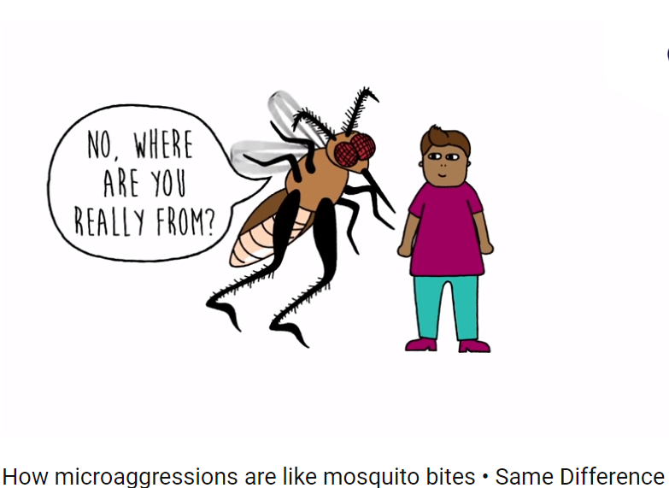
Microaggressions
https://www.youtube.com/watch?v=hDd3bzA7450
Notes:
-Spee gets up the video on YouTube.
-Shirley introduces it.

Slide 9

Pathway to Actively Intervening
INTERVENTION!
Possessing strategies
Responsibility to act
Knowledge of a situation
Notes:
-Spee on the structure of the training
-Training goals: Provide resources and tools; practice what we preach/value; support larger commitment to love and protect one another

Slide 10
Bystander Basics
What are the biggest barriers to intervening?
Notes:
-Shirley facilitating and Spee putting down people’s thoughts on the flipchart paper
*What keeps you remaining a bystander?
*How do you know when a situation requires intervention?

Slide 11
Goals of Intervening
Reduce harm in the moment- make our presence known to the targeted person
In a verbal/argumentative attack- the goal isn’t to convince the perpetrator that they are wrong, it is to show observers an alternative
Notes:
-Shirley to review

Slide 12
Intervening
Be ALERT- scan your environment - pay attention to body cues
Remember to breathe
Say “NO!”
Go into a situation with a buddy (whenever possible)
Notes:
-Shirley

Slide 13
Notes:
Spee - Handout - Get volunteers to read aloud each “Do” and “Don’t”
Hold questions until the end – Q&A mostly

Slide 14
4 Ds of De-Escalation
Direct
Distract
Delegate
Delayed Response
Notes:
Spee to review - Handout

Slide 15

Role Plays!
Notes:
-Spee - Instructions: Get into groups of 4 people. Take a handout. Do the role play. Discuss how it went. Do the role play again, with same roles or switched around.
-Spee - After two rounds, reconvene the group.
Scenario 1 – Verbal harassment on the train
Scenario 2 – Shopping trip
Scenario 3 – Police harassing

Slide 16
Scenario 1
What would you do?
Verbal harassment on the bus, where the person being targeted appears uncomfortable and unsure of how to respond.
Description: You and a friend are riding on the bus, it’s crowded, and you notice a white man muttering slurs and threats under his breath towards a younger person of color near him. You are nearby and notice there is more room at the other end of the bus. What do you do?
Notes:
-Spee to read

Slide 17
Scenario 2
What would you do?
Public, verbal abuse, where the person being targeted is responding assertively.
Description: You and your friend are walking in a shopping area, and you overhear yelling. You stop and notice that a man you perceive to be white is shouting aggressively at an older Black woman, including telling her to “get a job.” She is yelling back and pointing her cane at him, telling him to leave her alone. What do you do?
Notes:
-Spee to read

Slide 18
Scenario 3
What would you do?
A situation involving the police harassing a stranger.
Description: You and a friend are walking home past the drugstore and notice two police officers harassing someone who appears to be homeless and telling them they cannot sit on the sidewalk. You also observe that the manager/employee of the store is watching the situation. What do you do?
Notes:
-Spee to read

Slide 19
Questions? Takeaways?
THANK YOU!
Notes:
Shirley - debriefing – What did you experience? What did you learn?
Spee – taking notes on flipchart
Spee and Shirley – concluding: hoping this was a good learning experience, appreciate any feedback as likely will do again, we want to all be in this together

Slide 20
Resources
People’s Response Team curriculum
www.peoplesresponseteamchicago.org
Dos and Don’ts of bystander intervention
https://www.afsc.org/resource/dos-and-donts-bystander-intervention
4 ds of Bystander Intervention
https://thoughtcatalog.com/abbey-fox/2013/07/the-four-ds-of-bystander-intervention-how-to-make-the-world-a-better-place/

